Slide 2
AI takes Autonomous Navigation to Mars and Beyond

Slide 3



AI takes Autonomous Navigation to Mars and Beyond
Kritika Ramani
Senior Manager, Quality Engineering
MathWorks
Maria Gavilan-Alfonso
Technical Program Manager, Education Marketing
MathWorks
Chinmayi Lanka
Manager, Quality Engineering
MathWorks

Slide 4
Why explore Mars?

Slide 5
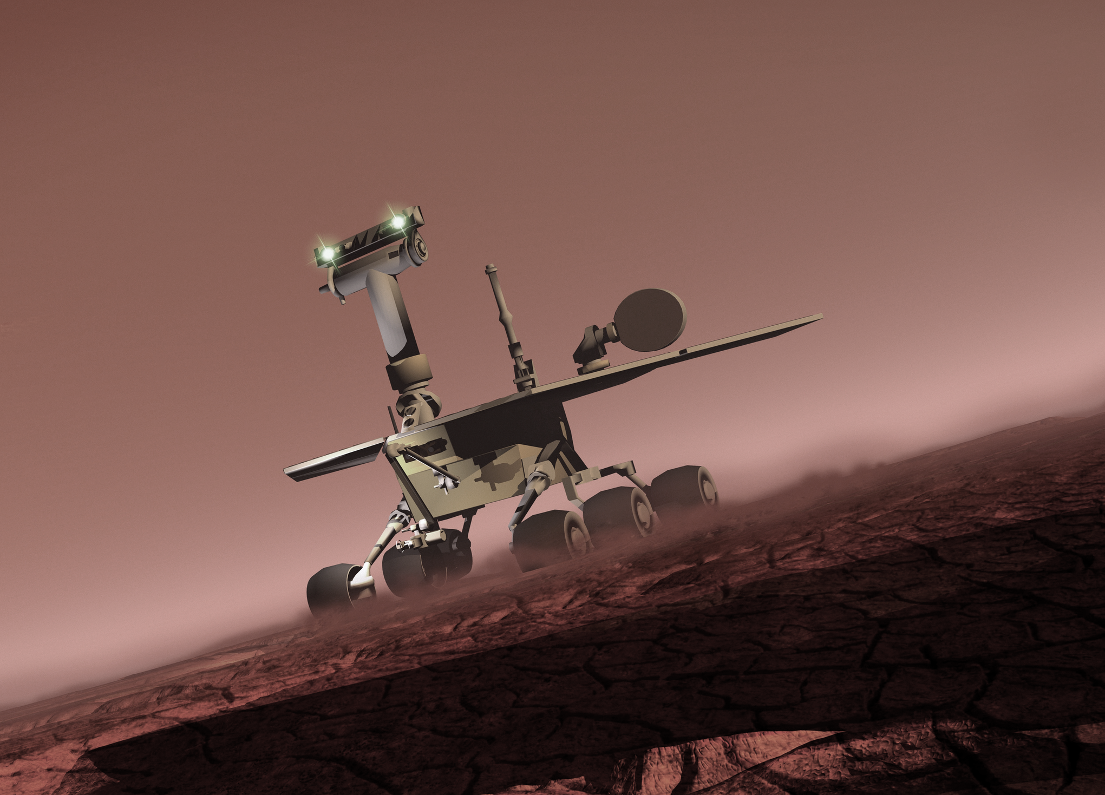
Exploring Mars helps us understand ancient life and water activity by collecting soil/rock samples

Slide 6



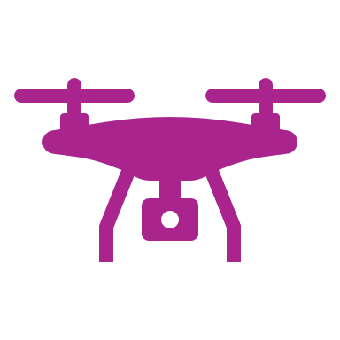







We have learnt a great deal from past missions and major discoveries
2011: Curiosity Rover
2016: ExoMars Orbiter
2020: Perseverance & Ingenuity
2003: Mars Express
2003: Spirit Rover
2001: Mars Odyssey

Slide 7









There are multiple challenges when we navigate Mars
Communication
Energy
Mapping

Slide 8
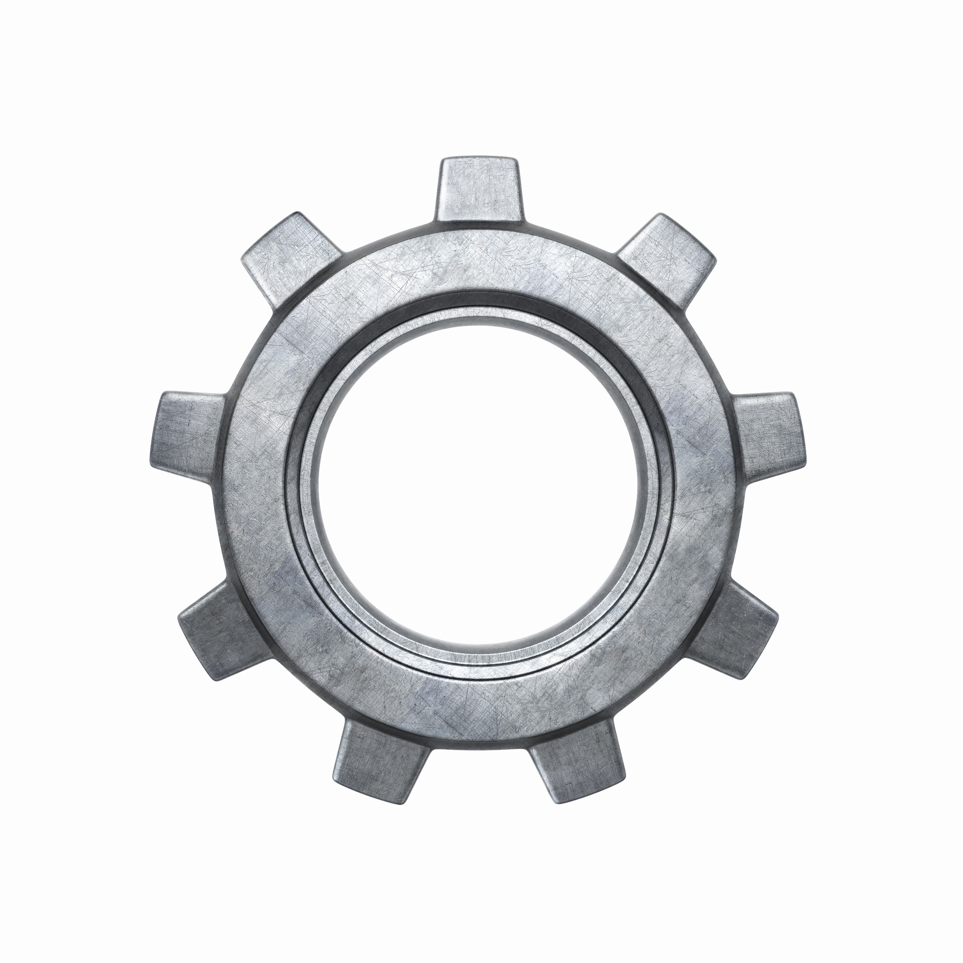
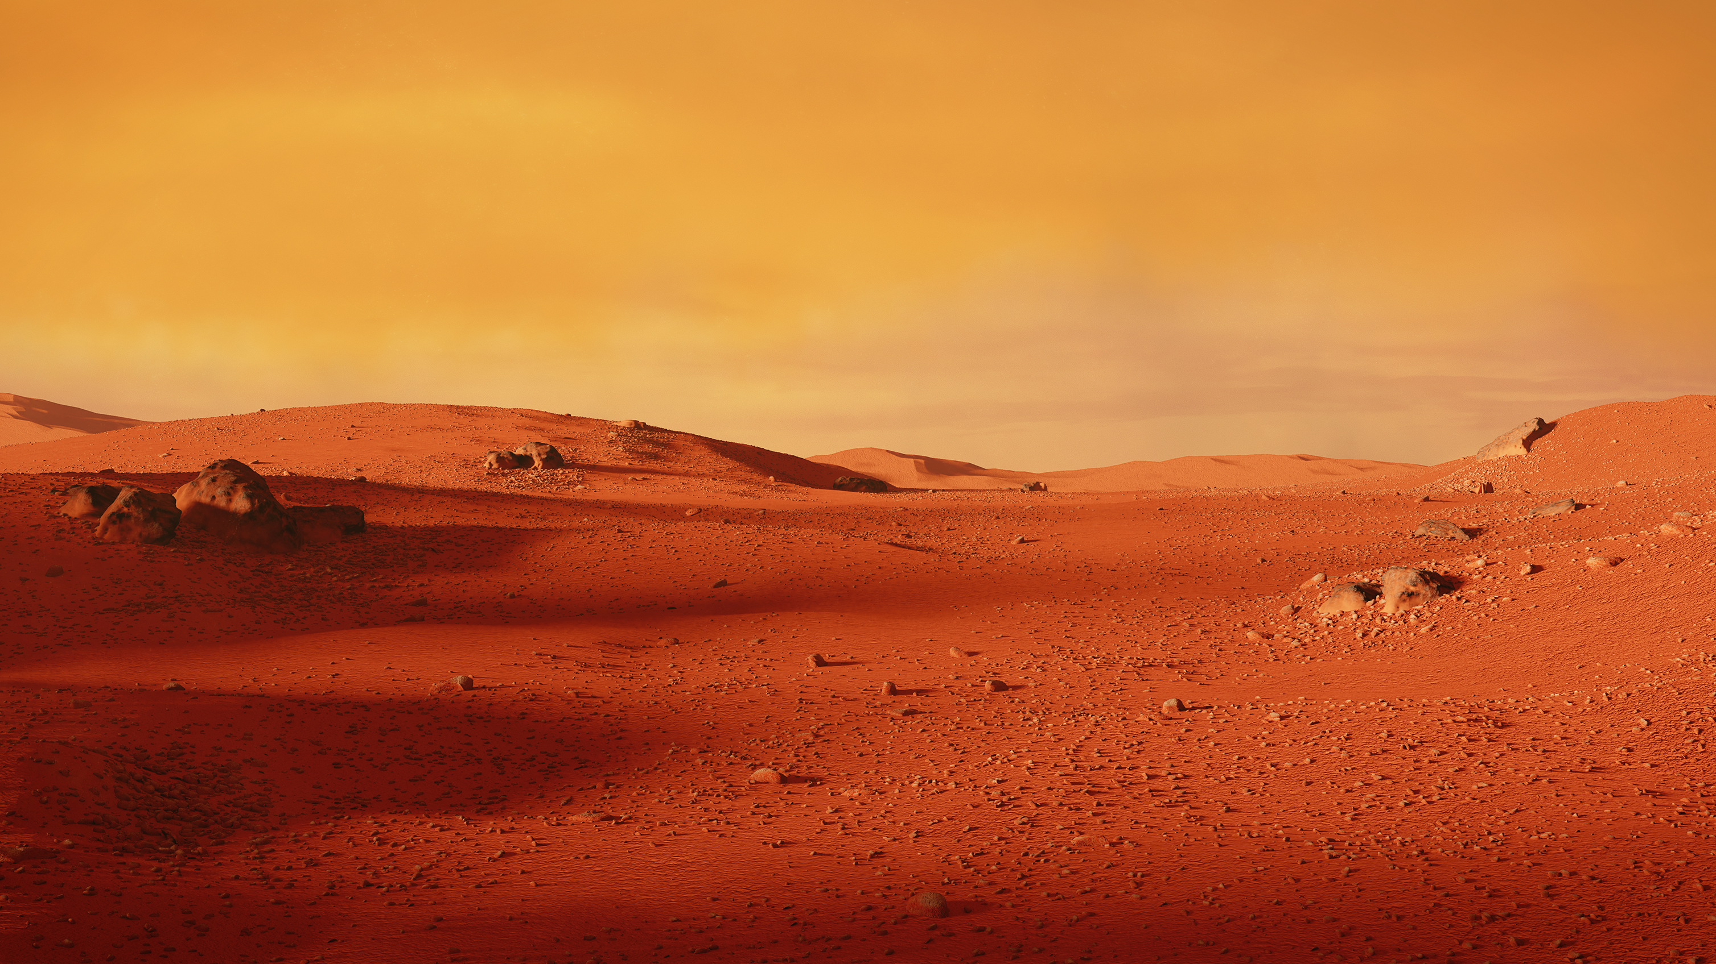

Simulations help in validating rover’s capability to complete missions successfully
Expensive Hardware
Uncharted territories
Mission
critical

Slide 9
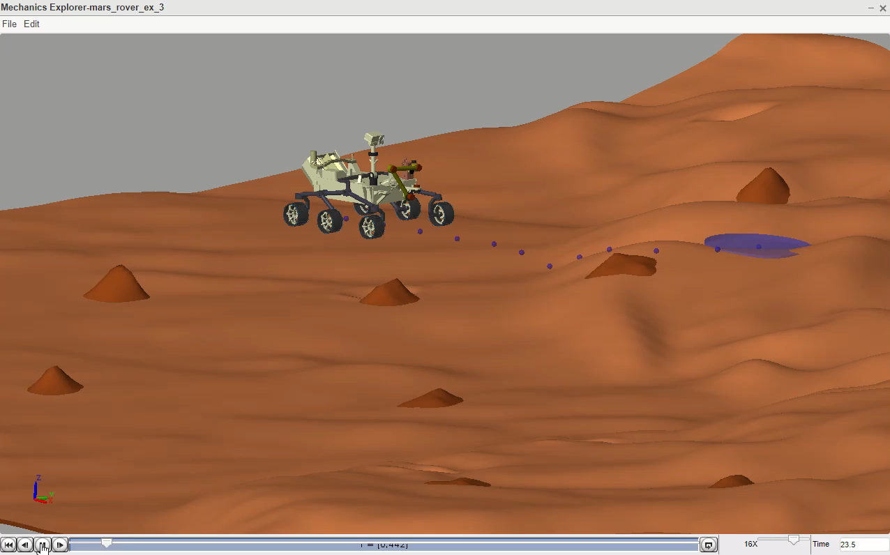
Today’s mission
Simulate navigation of an autonomous rover on a virtual Mars environment

Slide 10



Our mission can be split into multiple tasks
Where am I? Calibration
What do I see?
Object Detection
Where can I go?
Navigation

Slide 11

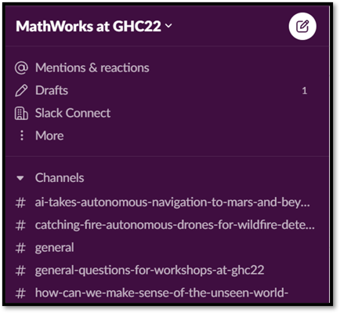

Join us on
https://tinyurl.com/mwtechhelpghc22
All necessary workshop materials / links will be available here

Slide 12
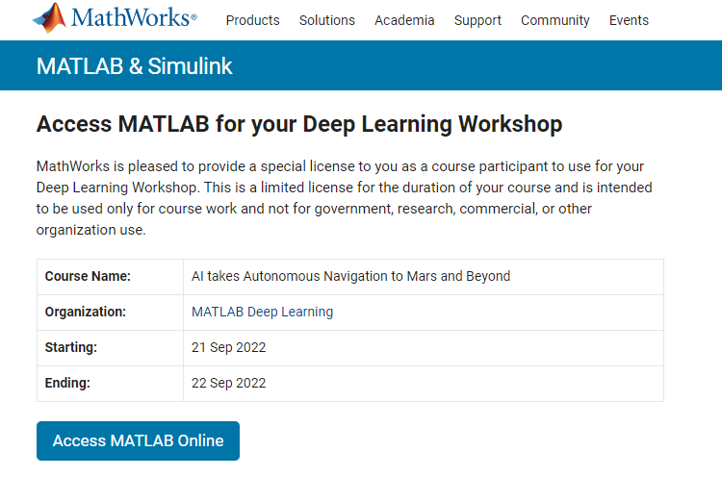
Today we will be using MATLAB Online
https://tinyurl.com/mw-ghc-mars-rover

Slide 13
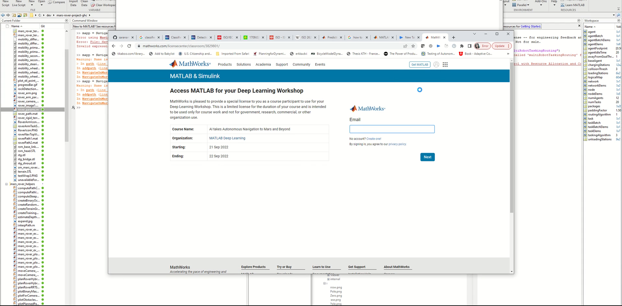

Get Access And Open Workshop exercises
SLACK link
https://tinyurl.com/mwtechhelpghc22
MATLAB Online link
https://tinyurl.com/mw-ghc-mars-rover

Slide 14
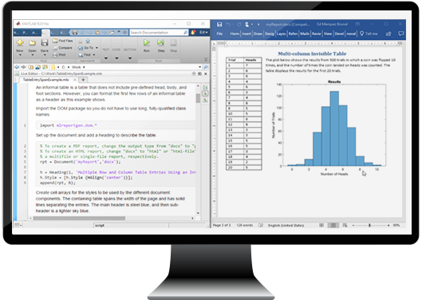
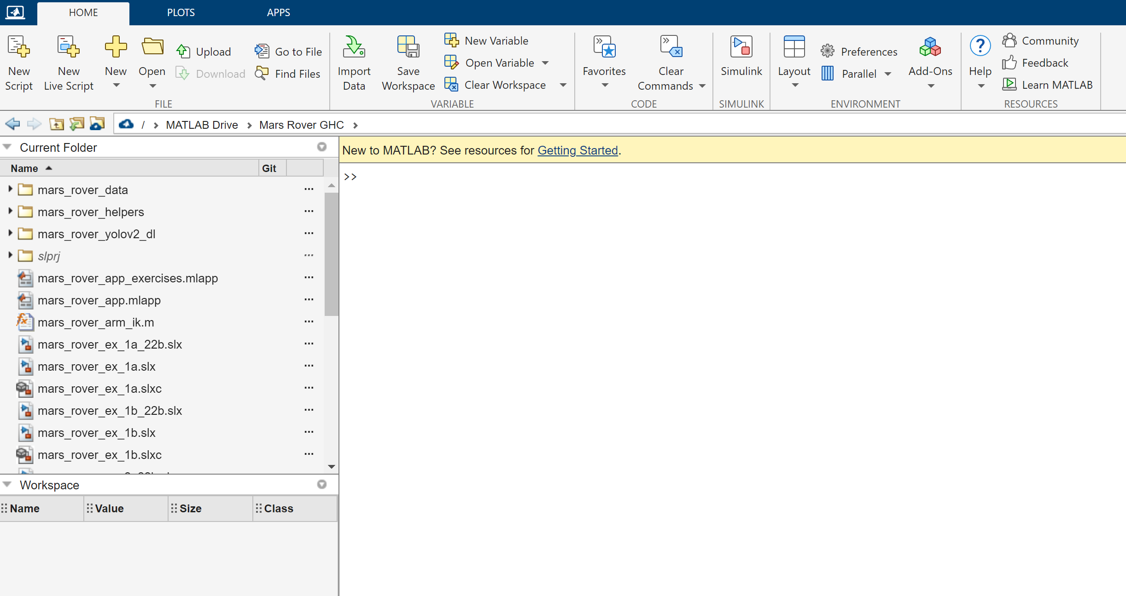

Open MATLAB Online
Once MATLAB Online is open, maximize the browser window We also strongly recommend
100% zoom for your browser
Do not use Dark Mode in the browser

Slide 15
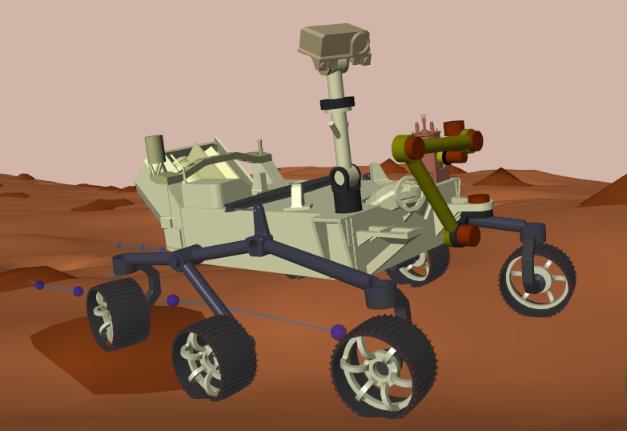
Multiple components are used to construct a physical model
Cameras
Robotic Arm
Wheels

Slide 16
Multiple components are used to construct a physical model
Chassis, Steering
Spatial Contact forces
Max velocity ( ~0.1 mph)
Mapping Environment

Slide 17
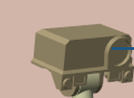
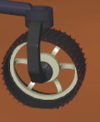
Software components serve as the backbone of the physical components
Maps
Drivers
Sensors
DNN Object Detector
Path
Planner
Controller
Estimator
Cameras
Encoders & IMU
Unknown
Known

Slide 18


Missions can be split into multiple tasks
Where am I? Calibration
What do I see?
Object Detection
Where can I go?
Navigation

Slide 19
Exercise 1 Rover: Where am I? (Calibration)

Slide 20

Autonomous systems can calibrate and orient using cached maps and other instruments
Rover Egress Phase
Check instruments
Check surroundings
Rover boot up
Calibration Path

Slide 21


Rovers have a difficult time understanding their location
Imagine you are given a command to walk from your desk to the podium
BUT… scan area, eyes closed and now pursue walking

Slide 22


Rovers have a difficult time understanding their location
Like vehicles on earth, rovers on Mars also use wheel odometers to measure the distance it has traveled
IMU (Inertial Measurement Unit) returns accurate pose estimate but suffers on large drift due to integration
Wheel Odometer + IMU = Better Pose Estimation

Slide 23




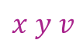
Kalman Filter helps in fusing multi-sensor measurement
A Kalman filter is an optimal estimation algorithm.
It helps estimate a system state when it cannot be measured directly
Our goal is to setup a filter to estimate the overall state of the robot:
$$States=[ x y θ v ω]$$
𝑦
$$Wheel Encoder$$
$$measurements$$
Linear position and linear velocity
$$x y v$$
$$IMU$$
$$measurements$$
Angular position and angular velocity
$$θ ω$$
𝛳
𝓍

Slide 24
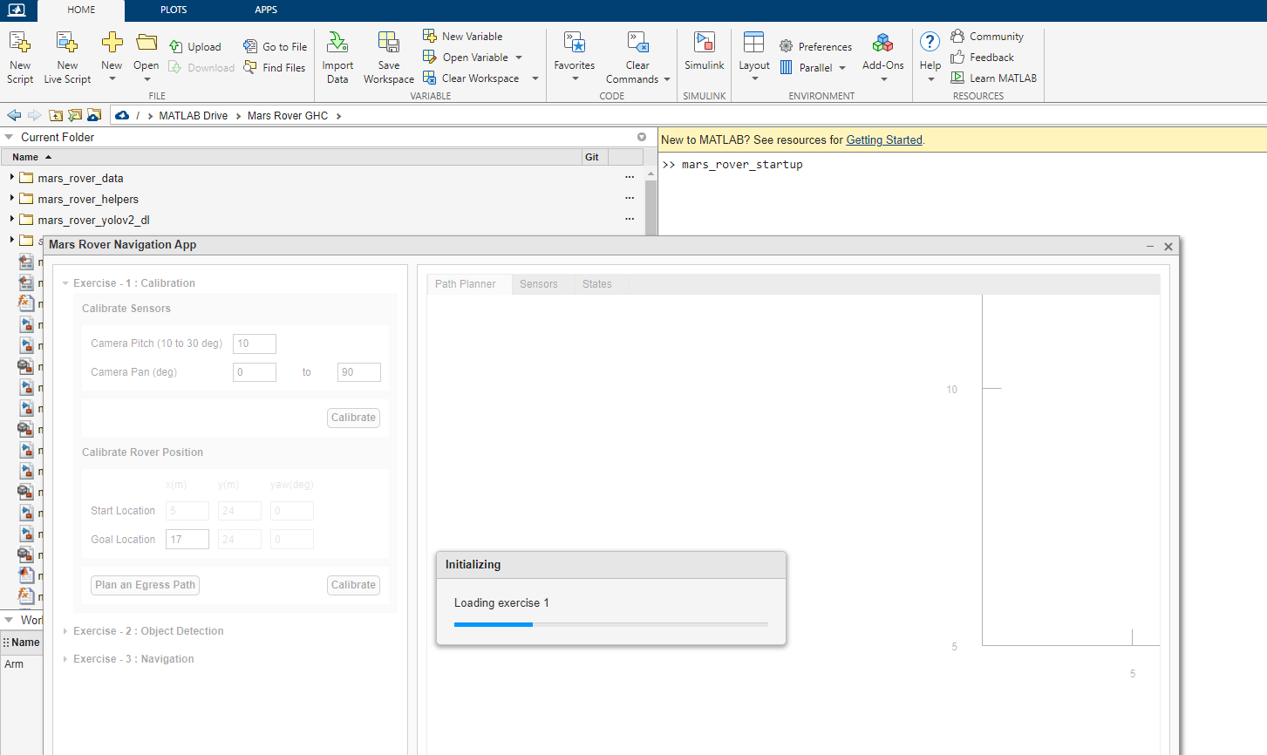
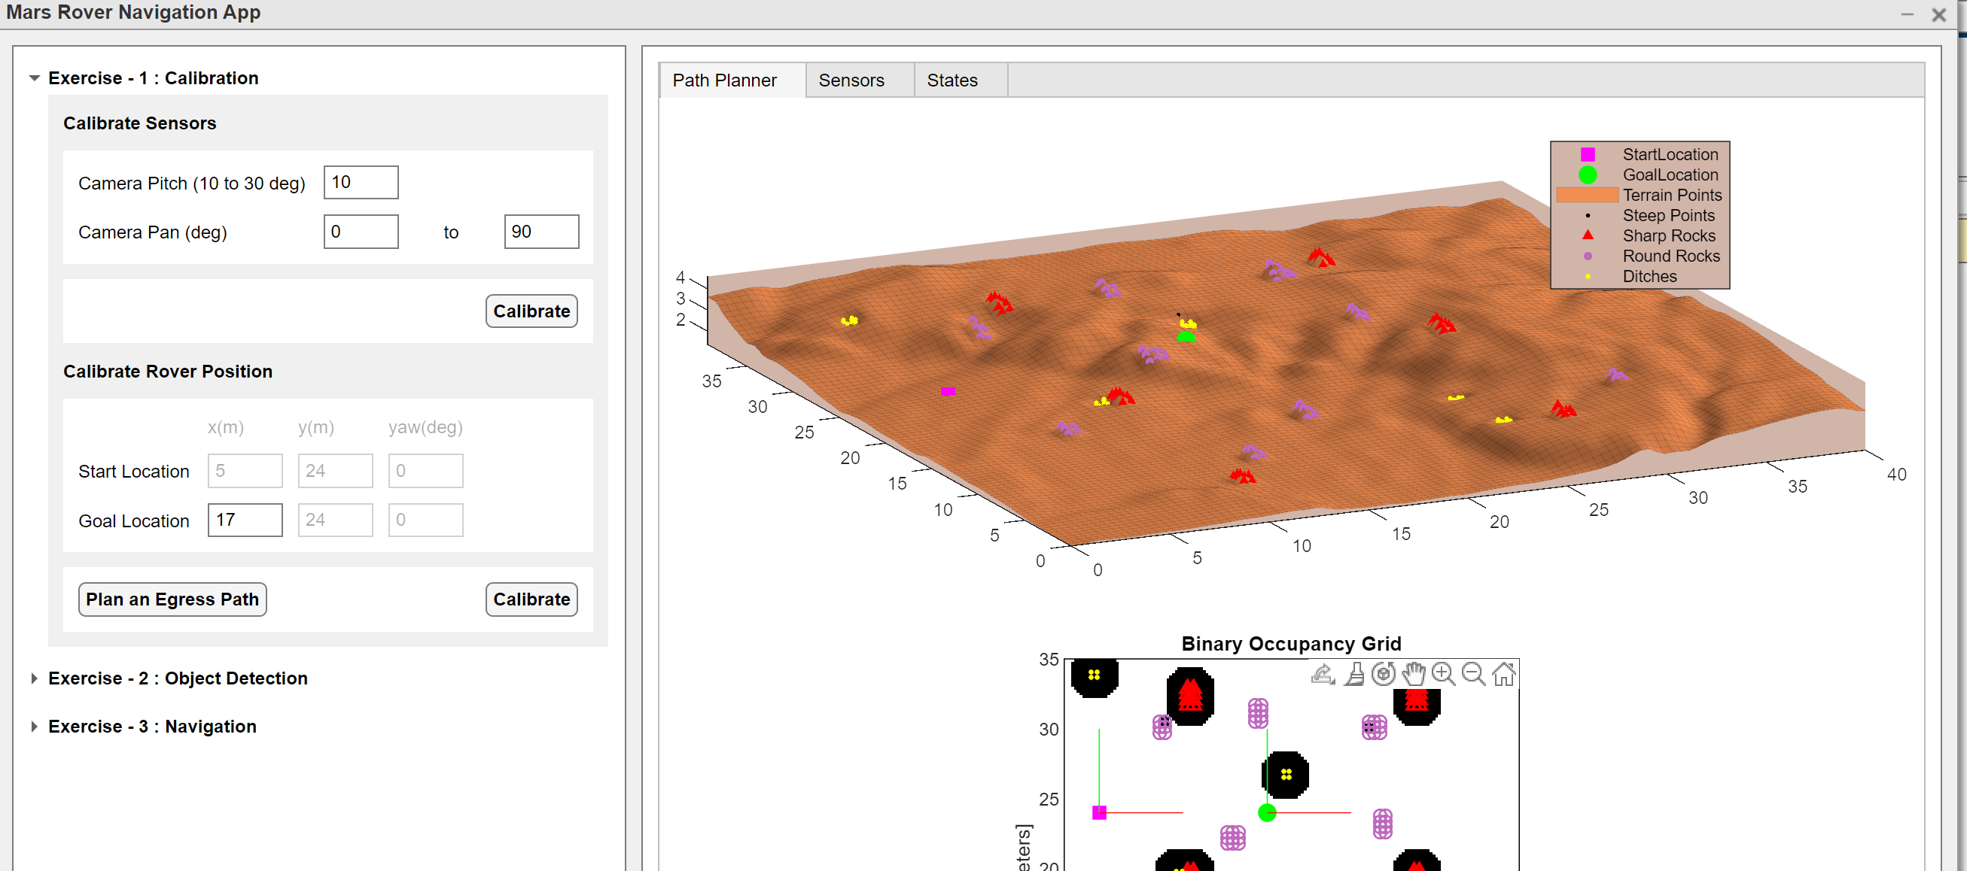
Your Interactive App should now be open
Let’s dive into our hands-on exercise

Slide 25
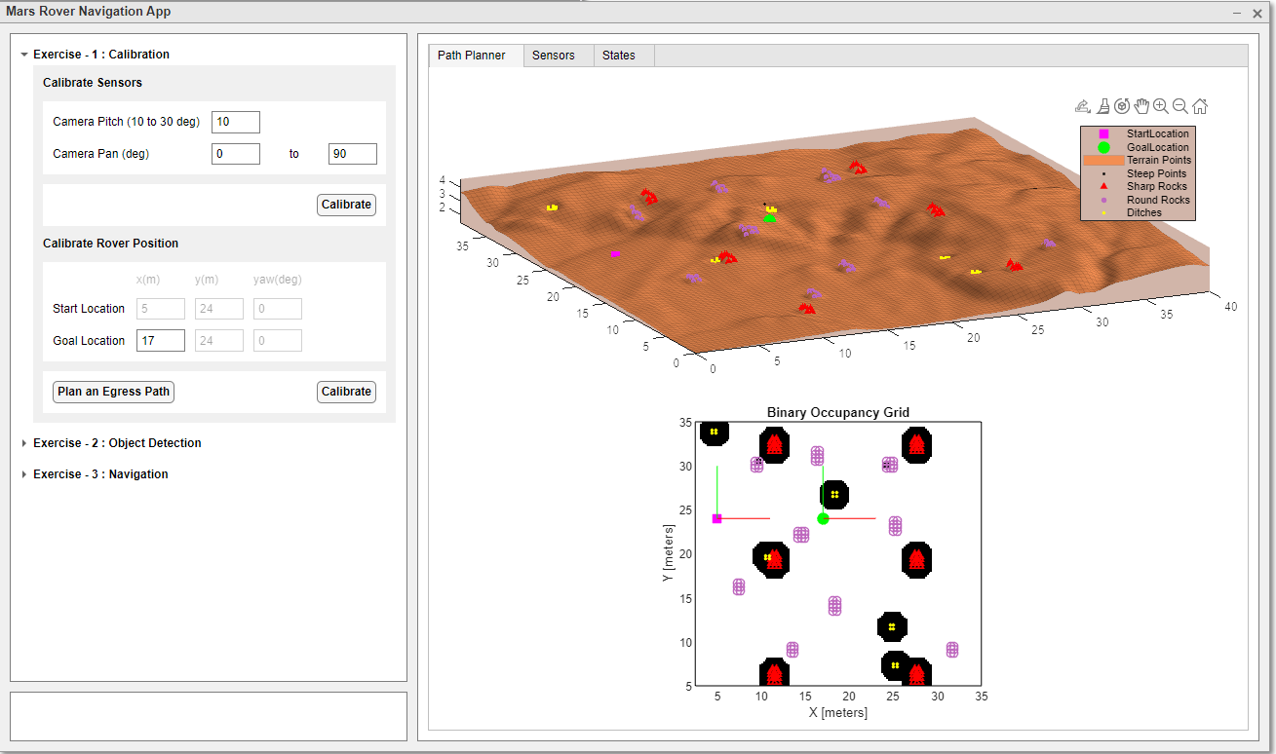
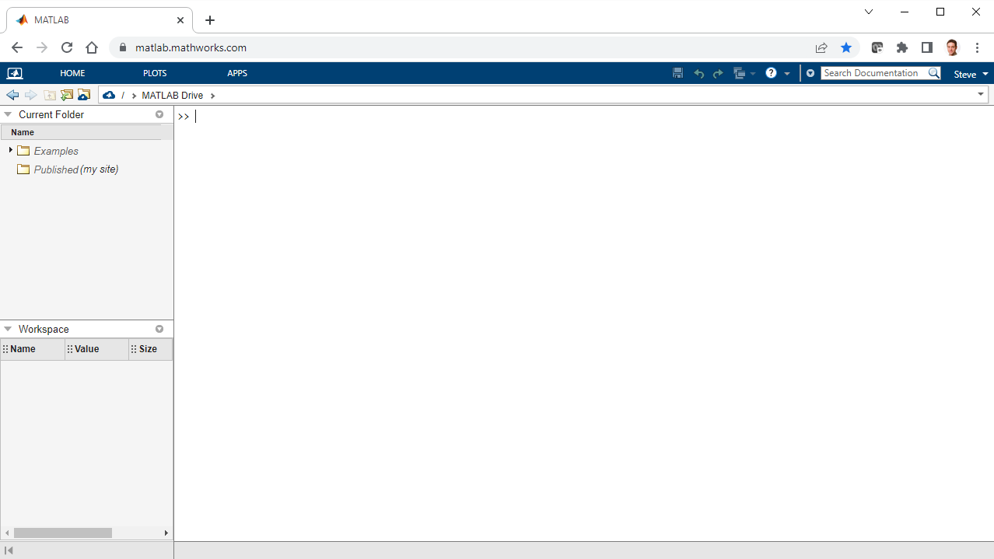
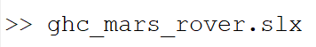
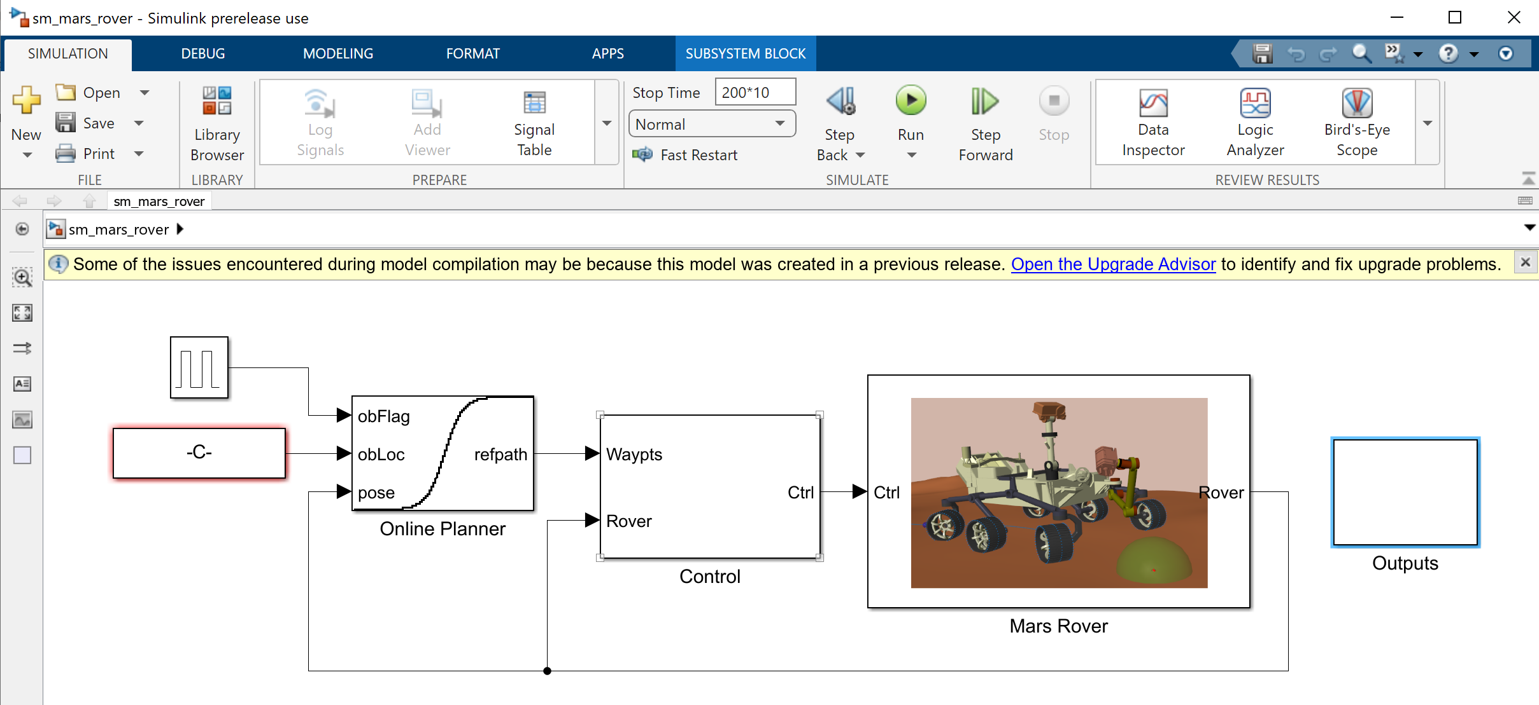
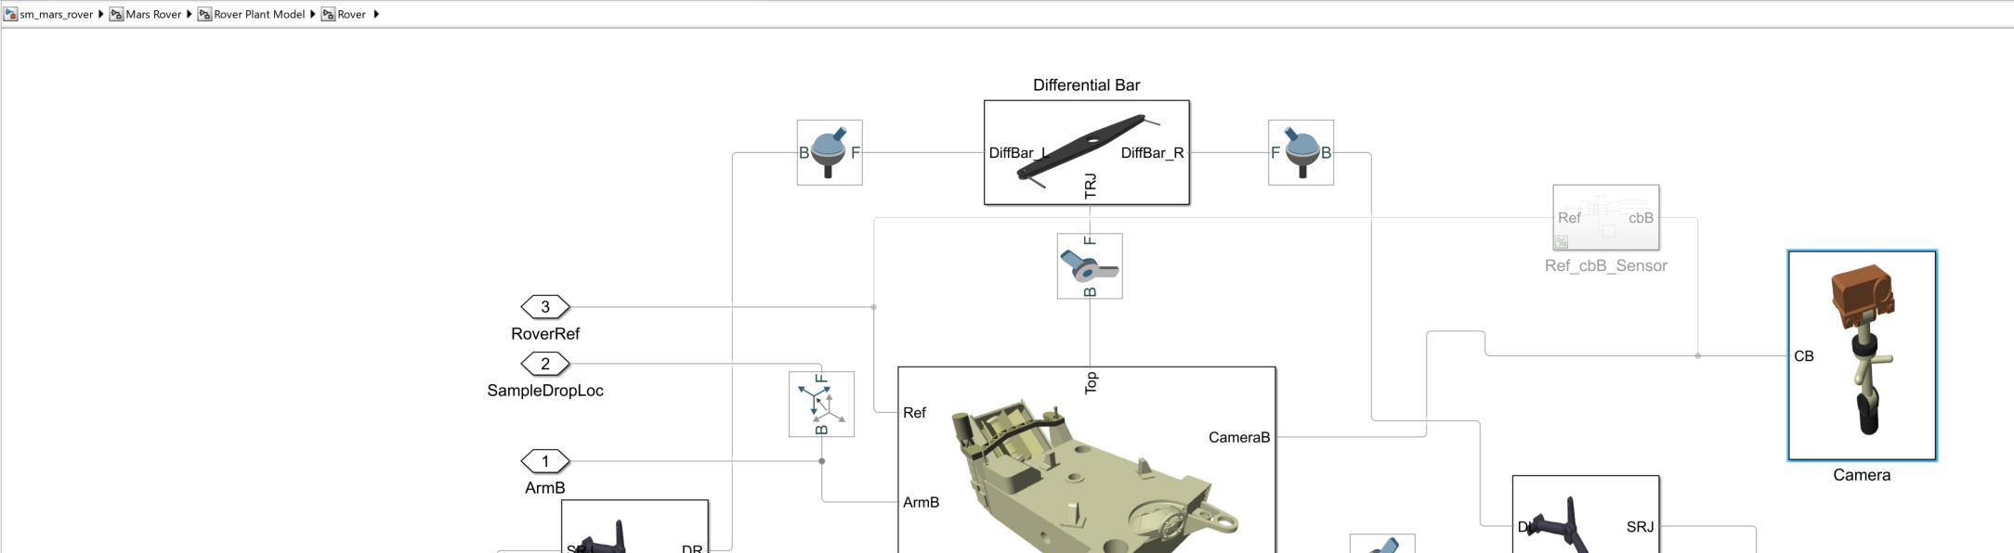
Calibrate sensors
Simulate the cameras to pan 360 degrees while the rover being stationary
Observe the camera views and processed frames in the app to ensure they are calibrated

Slide 26
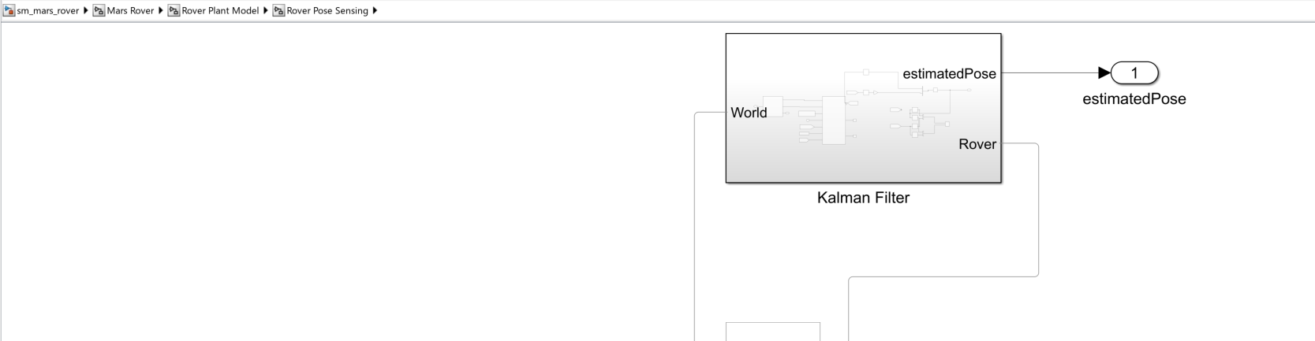
Calibrate linear positions
Simulate a straight path for the rover to move
Observe the state estimates for linear values such as x, y and heading angle

Slide 27
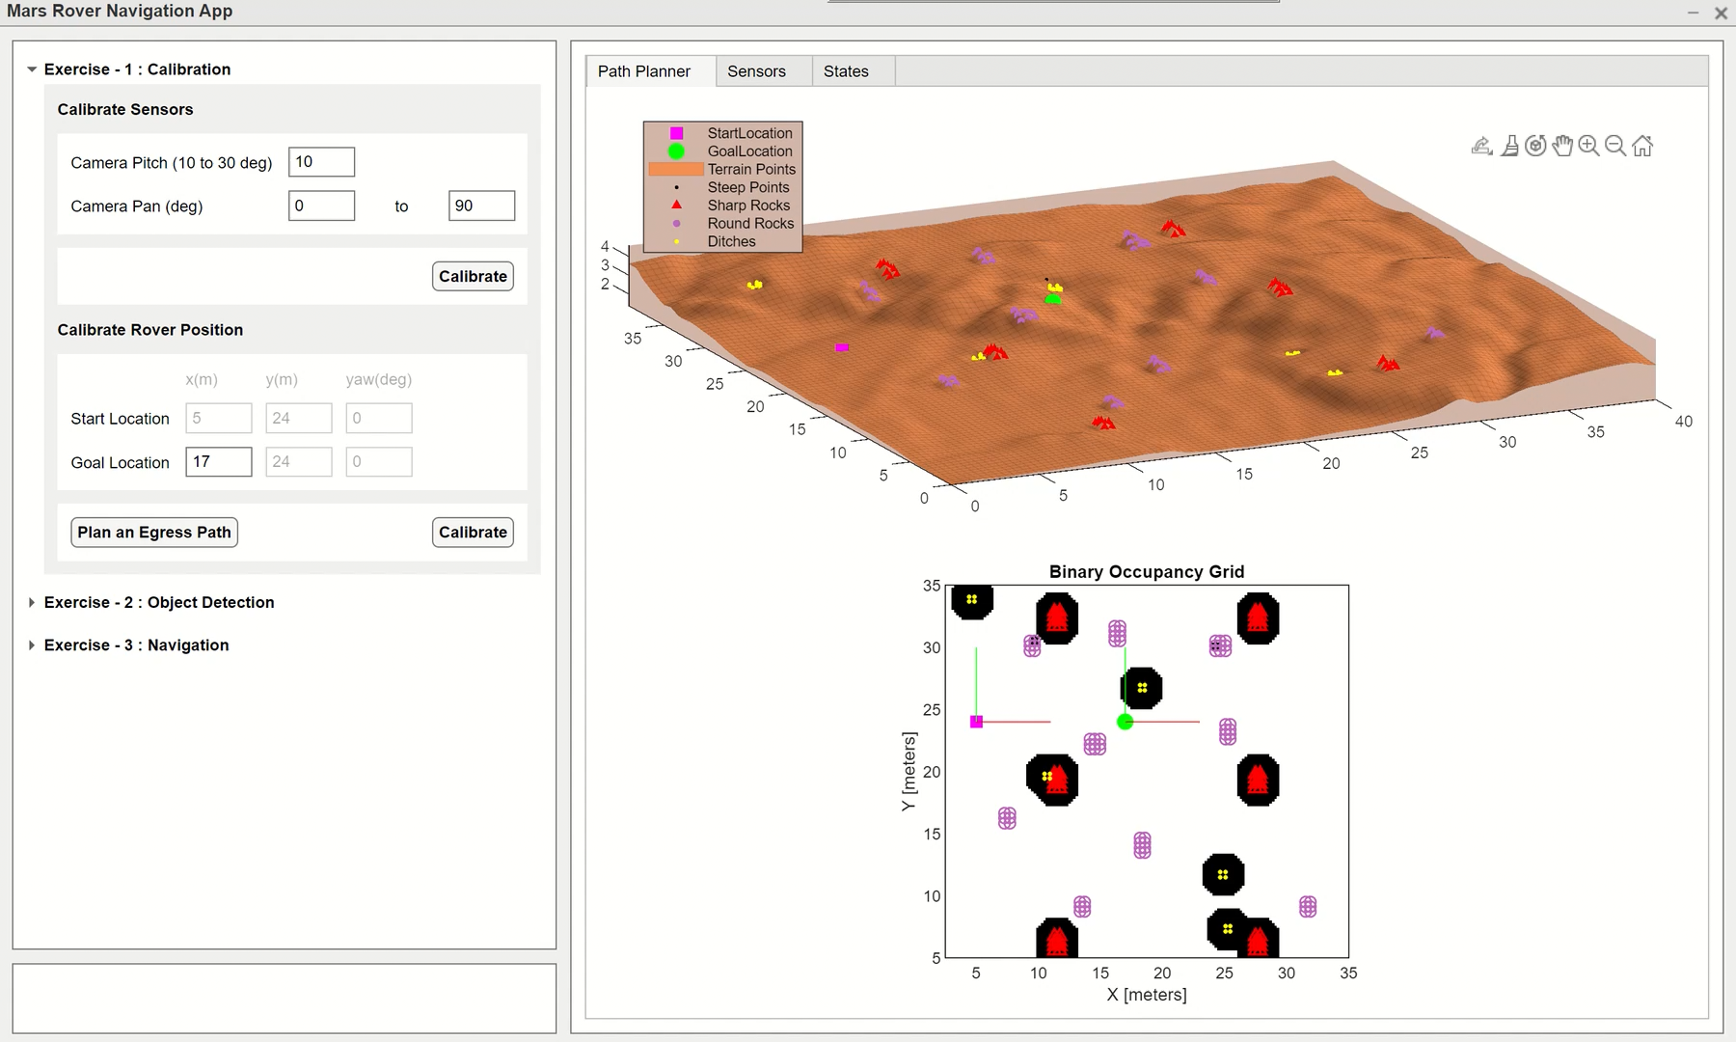
How was sensor calibration?

Slide 28
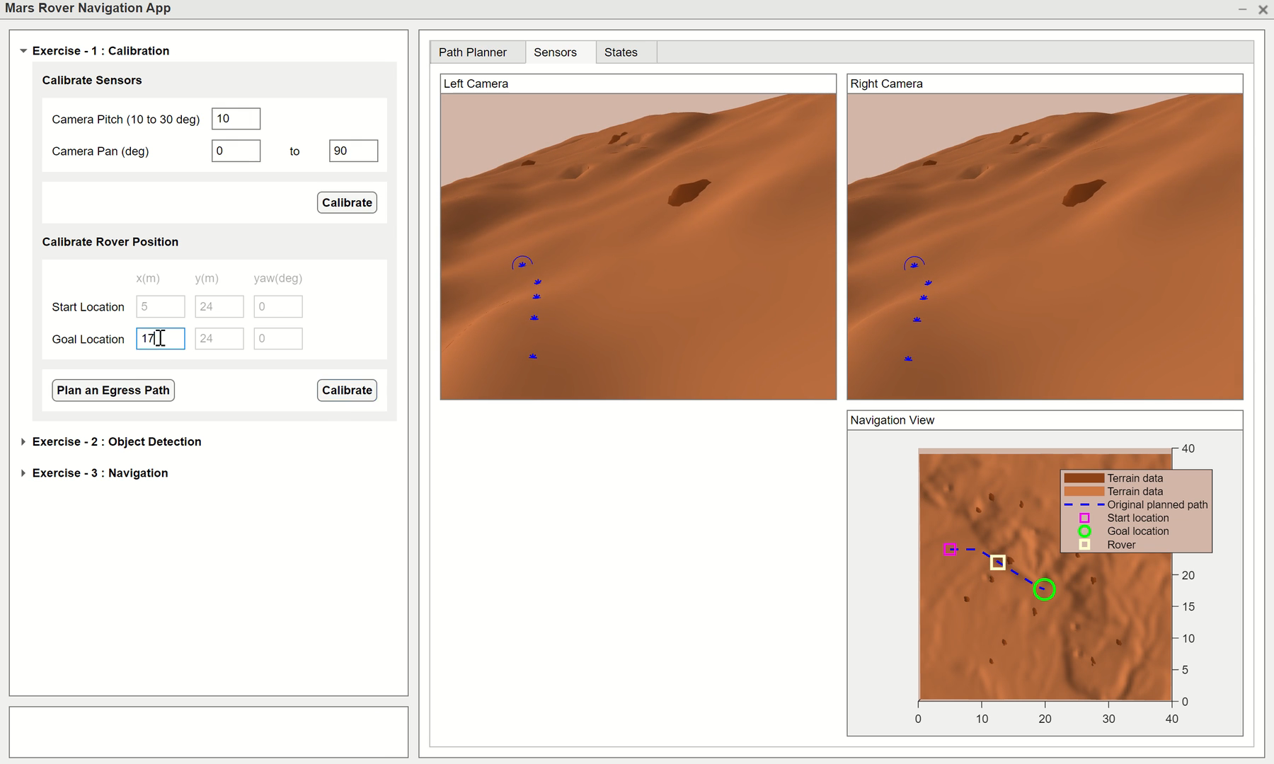
How was position calibration?

Slide 29

After calibration, the rover is ready to complete it’s assigned tasks using AI
Where am I? Calibration
What do I see?
Object Detection
Where can I go?
Navigation

Slide 30
Exercise 2 Rover: What do I see? (Obstacle Detection)

Slide 31
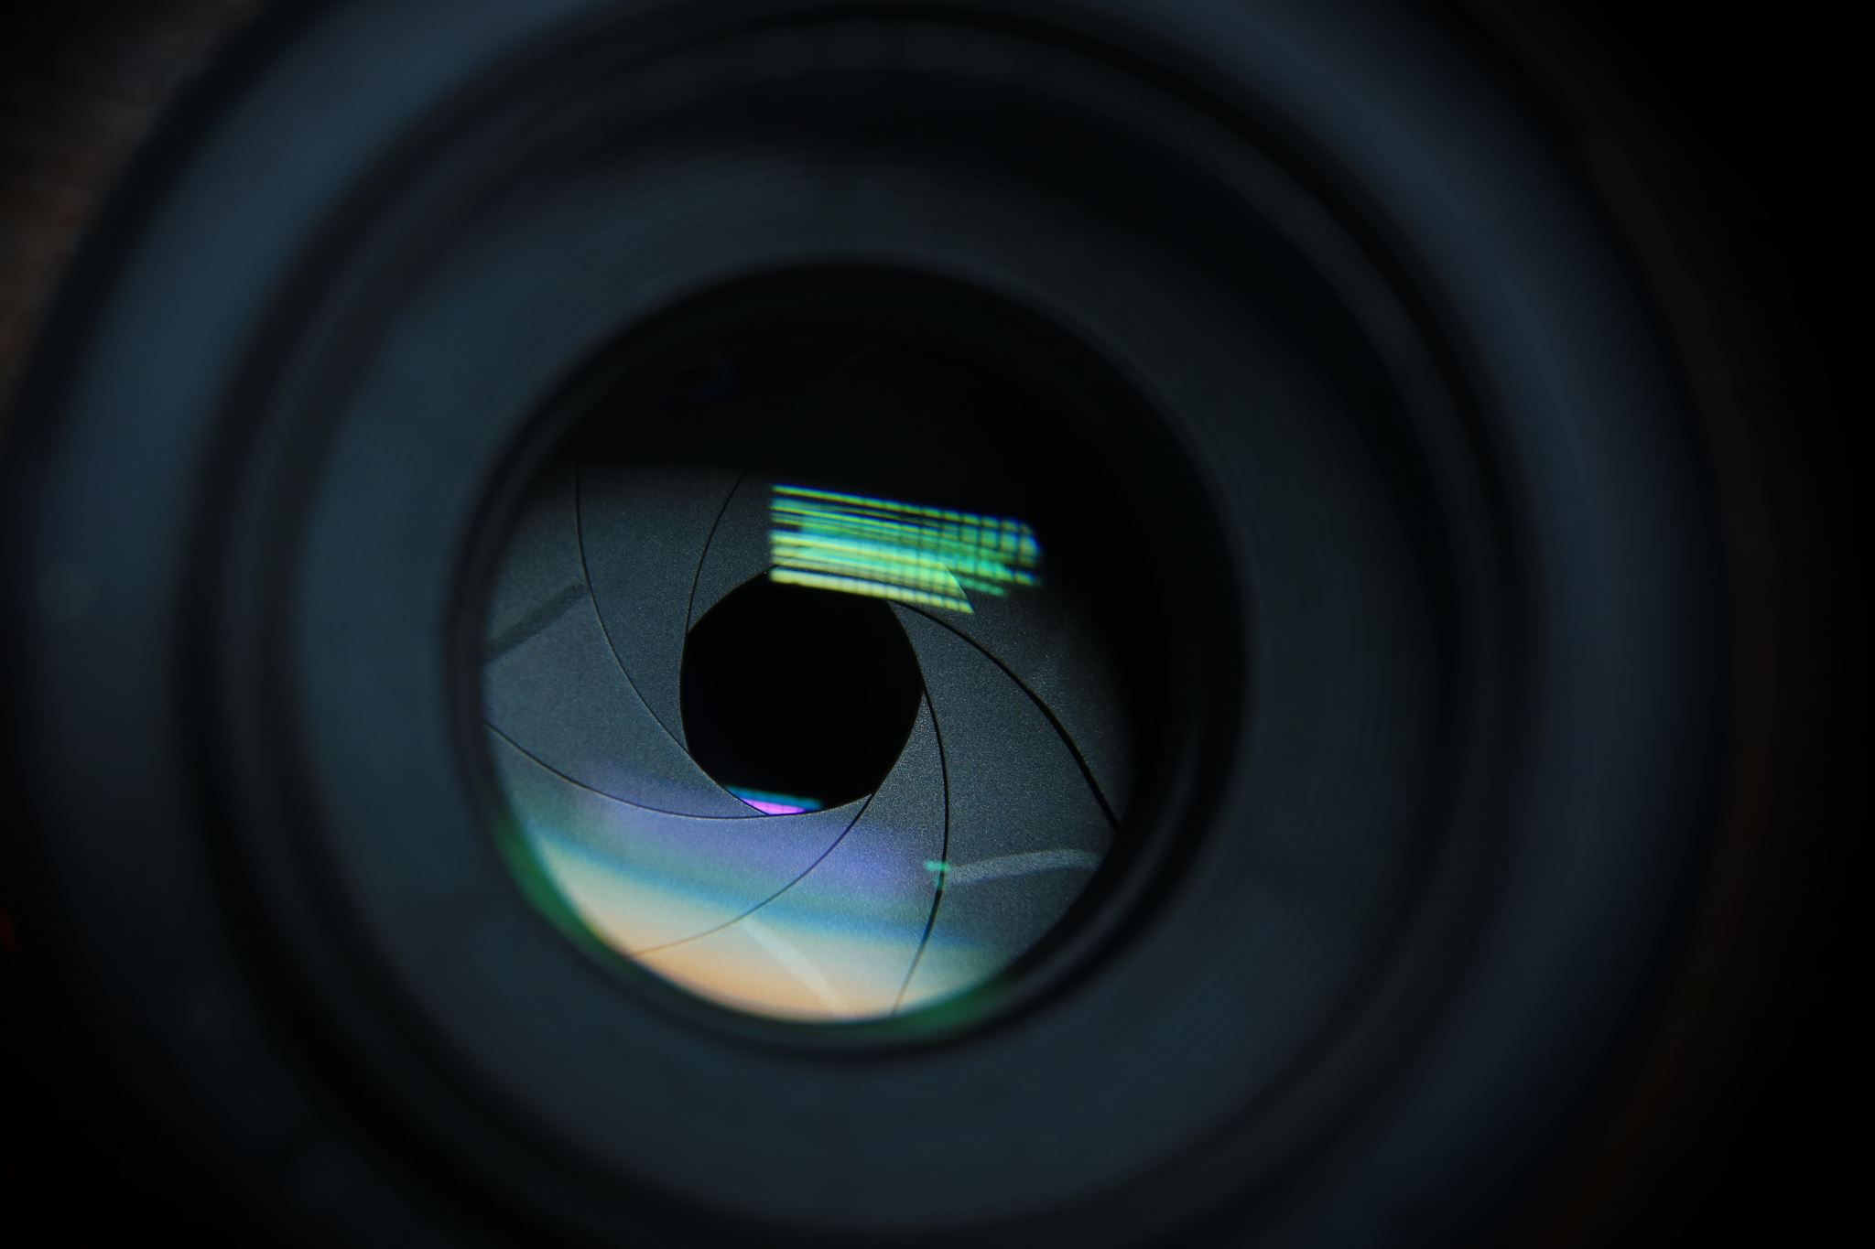
After calibration, the rover needs to traverse the terrain
Recall our mental exercise…
scan area, eyes closed and now pursue walking
Camera sensors on the calibrated rover serve as the eyes

Slide 32
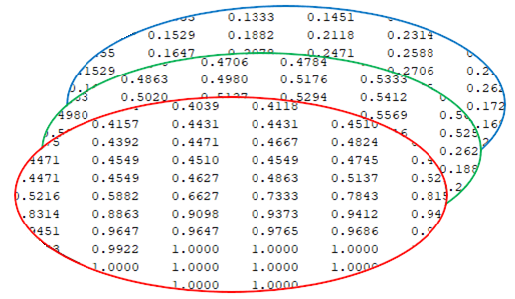
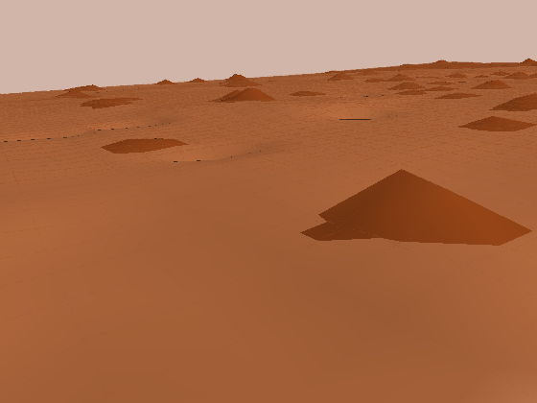
We can identify objects with vision sensors using AI techniques
The rover collects image data using both left & right sensors
Once images are collected, they will be modified into RGB matrices to preserve the features in an image.
right
left
These RGB matrices are then fed into a DNN to identify obstacles and other dangerous locations

Slide 33








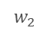
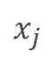

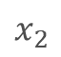
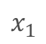

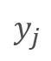
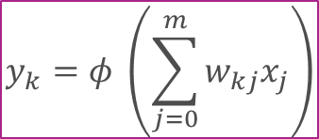



Artificial neural network forms the basis of DNN
Similar to neurons in brains, artificial neurons make up neural networks
Artificial Neuron:
Input -> Activation Layer -> Output
outputs
$$y_{k}=φ \left(\sum_{j=0}^{m}{w_{kj}x_{j}}\right)$$
inputs
$$x_{1}$$
$$w_{1}$$
$$x_{2}$$
$$w_{2}$$
$$Φ$$
$$y_{j}$$
$$x_{j}$$
$$w_{j}$$
activation

Slide 34
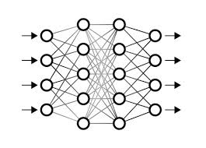
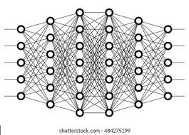
Deep Neural Networks are stacked neural networks
Simple Neural Network
Deep Neural Network

Slide 35



Deep Neural Network plays a pivotal role in identifying objects
Preprocessing Data
Object Detection Network
Train Network
Validate
Network is as good as your data
Resnet50 – feature extraction
60:20:20 ratio
Use the last 20%

Slide 36
There are two main tasks in Object Detection
Regions of proposal
rock
Classification + localization
rock

Slide 37



There are different approaches in DNN for Object Detection
Two Stage Detection
Regions of proposal
Classification + localization
Greater accuracy
Low inference speeds

Slide 38
Single stage detection is gaining popularity
Lower accuracy
High inference speeds
Regions of proposal
YOLOv2
You Only Look Once
Classification + localization
Single - Stage Detection

Slide 39
We pass image only once into the Deep Network (YOLOv2)
Bounding boxes + confidence
rock
rock
rock
Final inference
n x n grid on input
Class probability map

Slide 40
Stereo Vision algorithms help us estimate distances
Point Cloud & Disparity Map for Depth Estimation
Disparity Map Creation
Point Cloud Creation
Centroid Identification
Depth Calculation
1.16
1.3
0.54
Final inference (DNN)

Slide 41
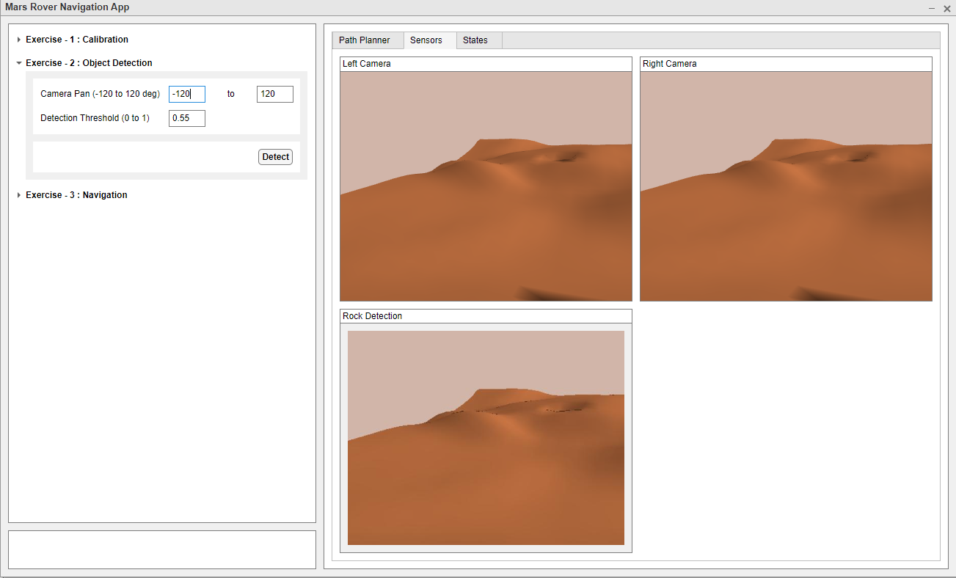
Access Ex2 in your interactive App
Let’s dive into our hands-on exercise
Explore the controls and identify objects on the Martian Environments

Slide 42
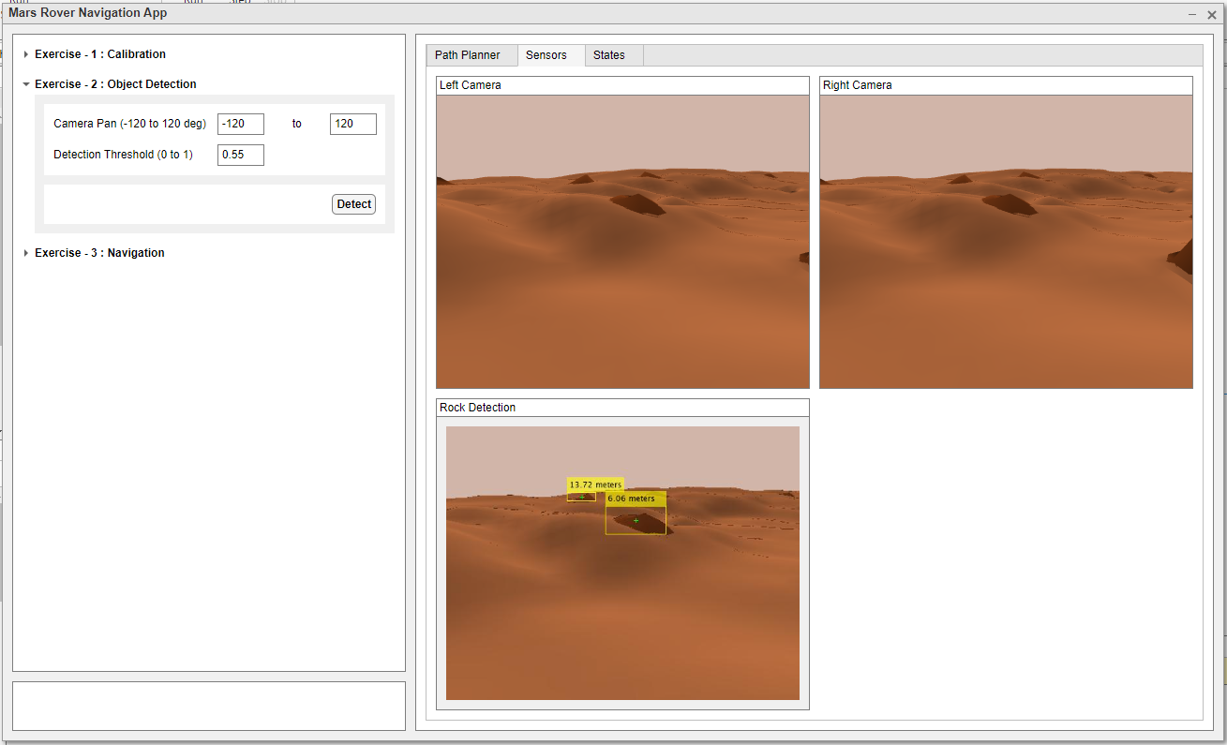
Scan and change detection threshold
Decide on your Pan values for your camera. This determines the width of your scanned area.
It can range from -120 deg to 120 deg
Now try to modify the value for your Detection Threshold. The initial value is set to 0.55 which seemed to be optimal.
This can range from 0 to 1

Slide 43
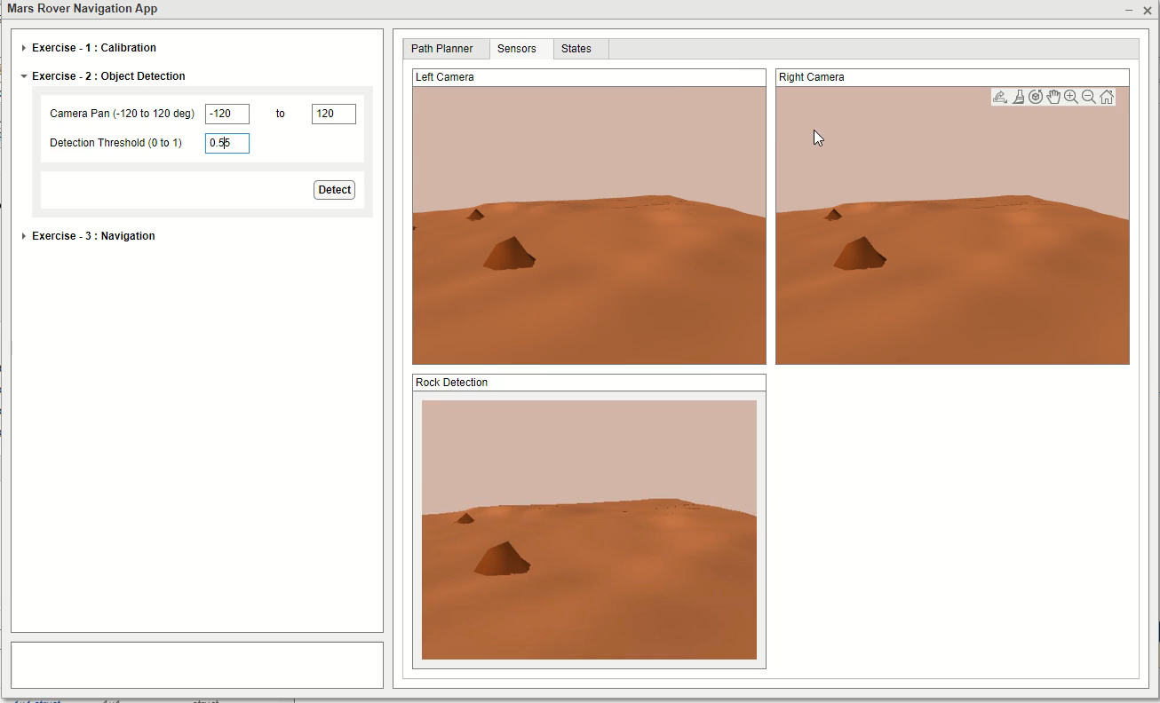
How did your network react?
What objects did you detect?
Any false positives?
Any false negatives?

Slide 44
Exercise 3 Rover: Where can I go? (Path Planning)

Slide 45

Onto the next task…
Where am I? Calibration
What do I see?
Object Detection
Where can I go?
Navigation

Slide 46
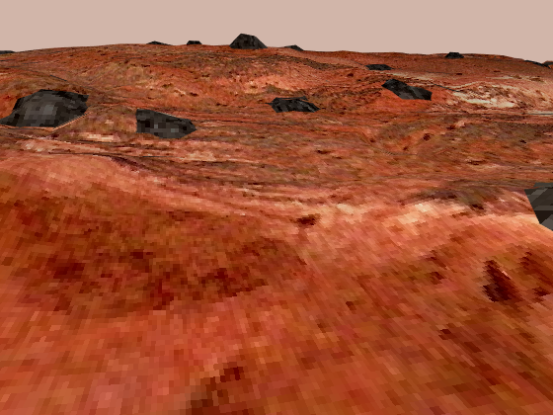
After correctly identifying objects, we need to traverse
Recall our previous exercise, we can now detect objects in our path
With predetermined maps and updates from DNN, the rover should be able to carry out its mission successfully

Slide 47
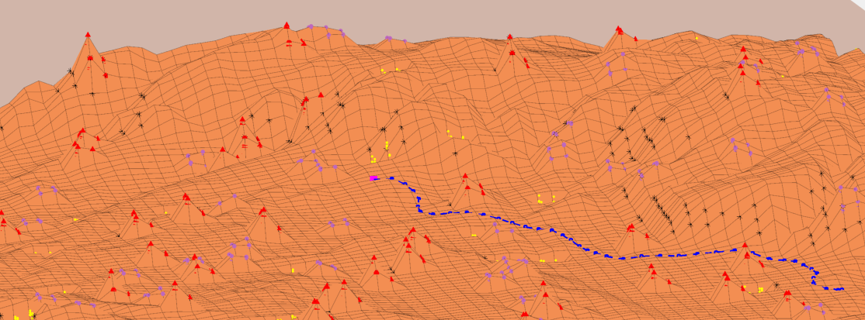


Navigating unknown terrains is complex and challenging
How do we solve the problem?
We perceive surroundings
Rocks
Sand
Unknown objects
Also consider details from our maps
We determine the target pose to plan an optimal path

Slide 48


Obstacle Avoidance helps navigate in unknown terrains
Path Planner
Compute Commands
Waypoints are a set of coordinates
Compute commands using Pure Pursuit
Result: Velocity and Theta
A to B?
Find an optimal path using A*
Result: Waypoints

Slide 49


Obstacle Avoidance helps navigate in unknown terrains
Path Planner
Compute Commands
Scan surroundings
Process frames from both cameras
Result: Frames
Pre-trained network
Process using stereo vision
Result: Bounding boxes & Distance
Process
Inputs
Detect
Obstacles

Slide 50

Obstacle Avoidance helps navigate in unknown terrains
Check if obstacle lies on planned path
Result: Poses & Flag
Compute Commands
Obstacle
Avoidance
Path Planner
Process
Inputs
Detect
Obstacles

Slide 51



Obstacle Avoidance helps navigate in unknown terrains
Send final velocity & heading commands to the rover
Result: Poses
Compute Commands
Obstacle
Avoidance
Send
Commands
Path Planner
Process
Inputs
Detect
Obstacles

Slide 52
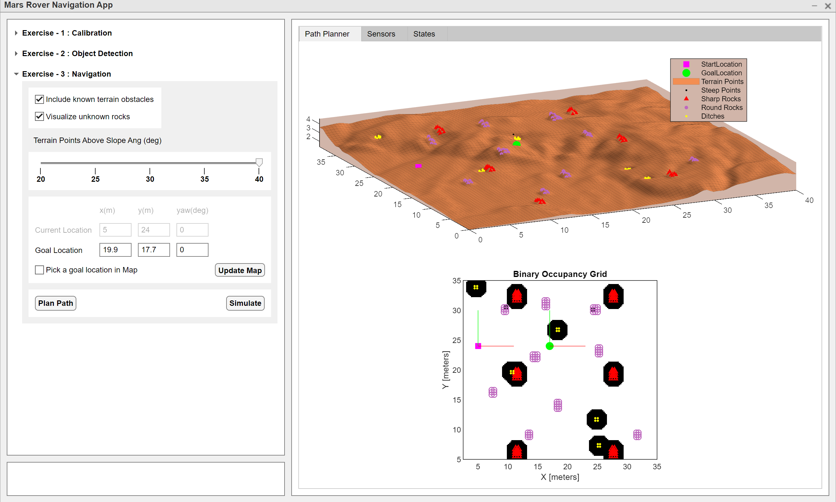
Navigate to a specific goal location
Let’s dive into our hands-on exercise
Let’s explore the app and help navigate the rover

Slide 53
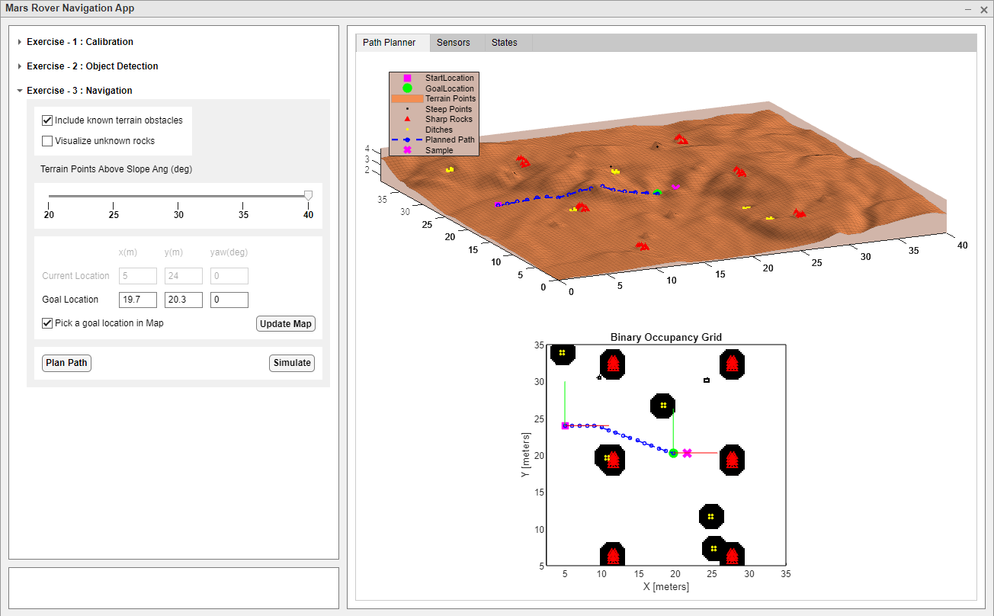


Choose to include/exclude unknown rocks
Select the checkbox
Observe the updates in the plot area

Slide 54
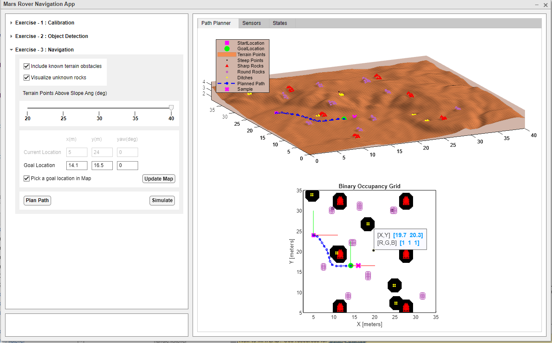
Specify Goal Position and plan a path
Either pick a point for goal location or modify them in the edit fields
Hit “Update Map” to observe the results in the map area
Hit “Plan Path” to visualize the planned path on the Occupancy map.
Then press “Simulate” to get your rover moving.

Slide 56
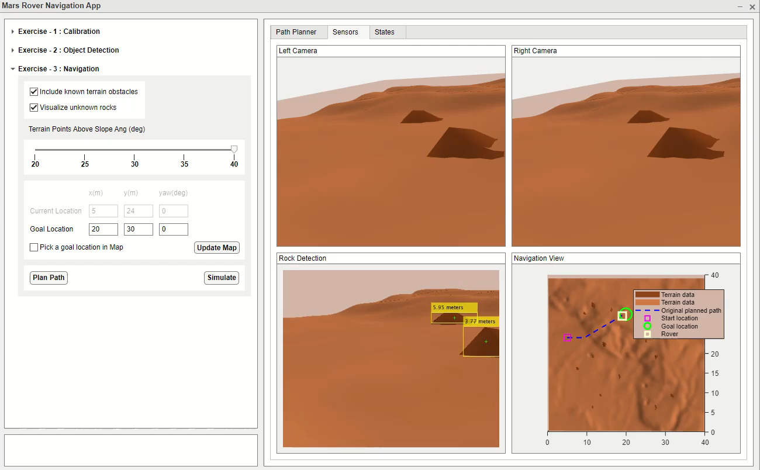
How did your workflow go?

Slide 57
How did your rover perform?
What objects did you detect?
Did you avoid obstacles?

Slide 58
What did you learn today?

Slide 59
Navigating the Mars terrain using AI in a simulated environment
Calibration
Detection
Navigation

Slide 60

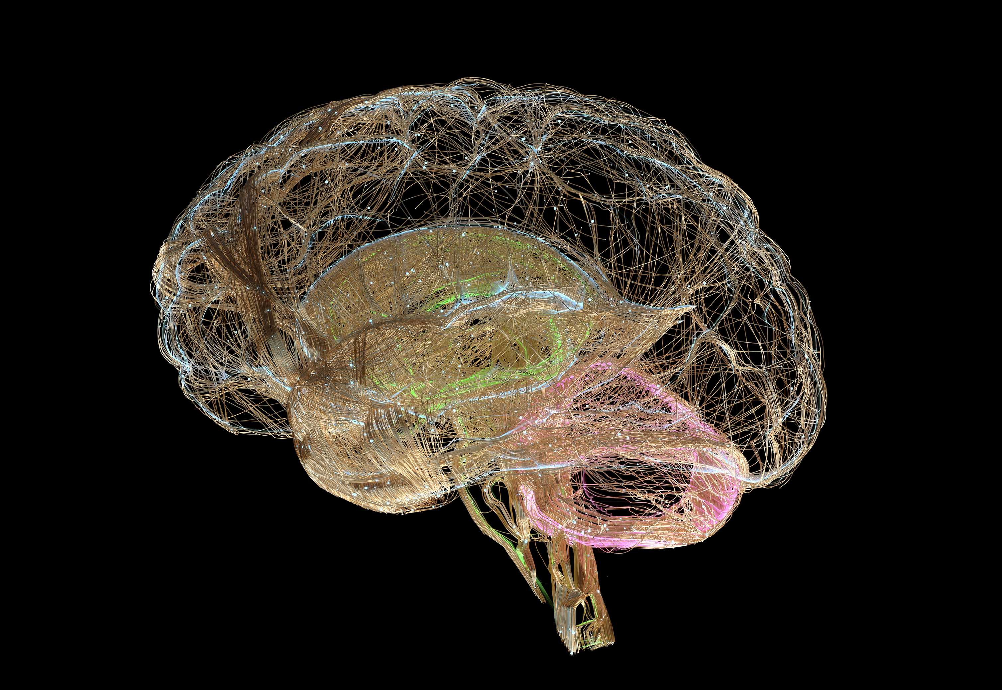
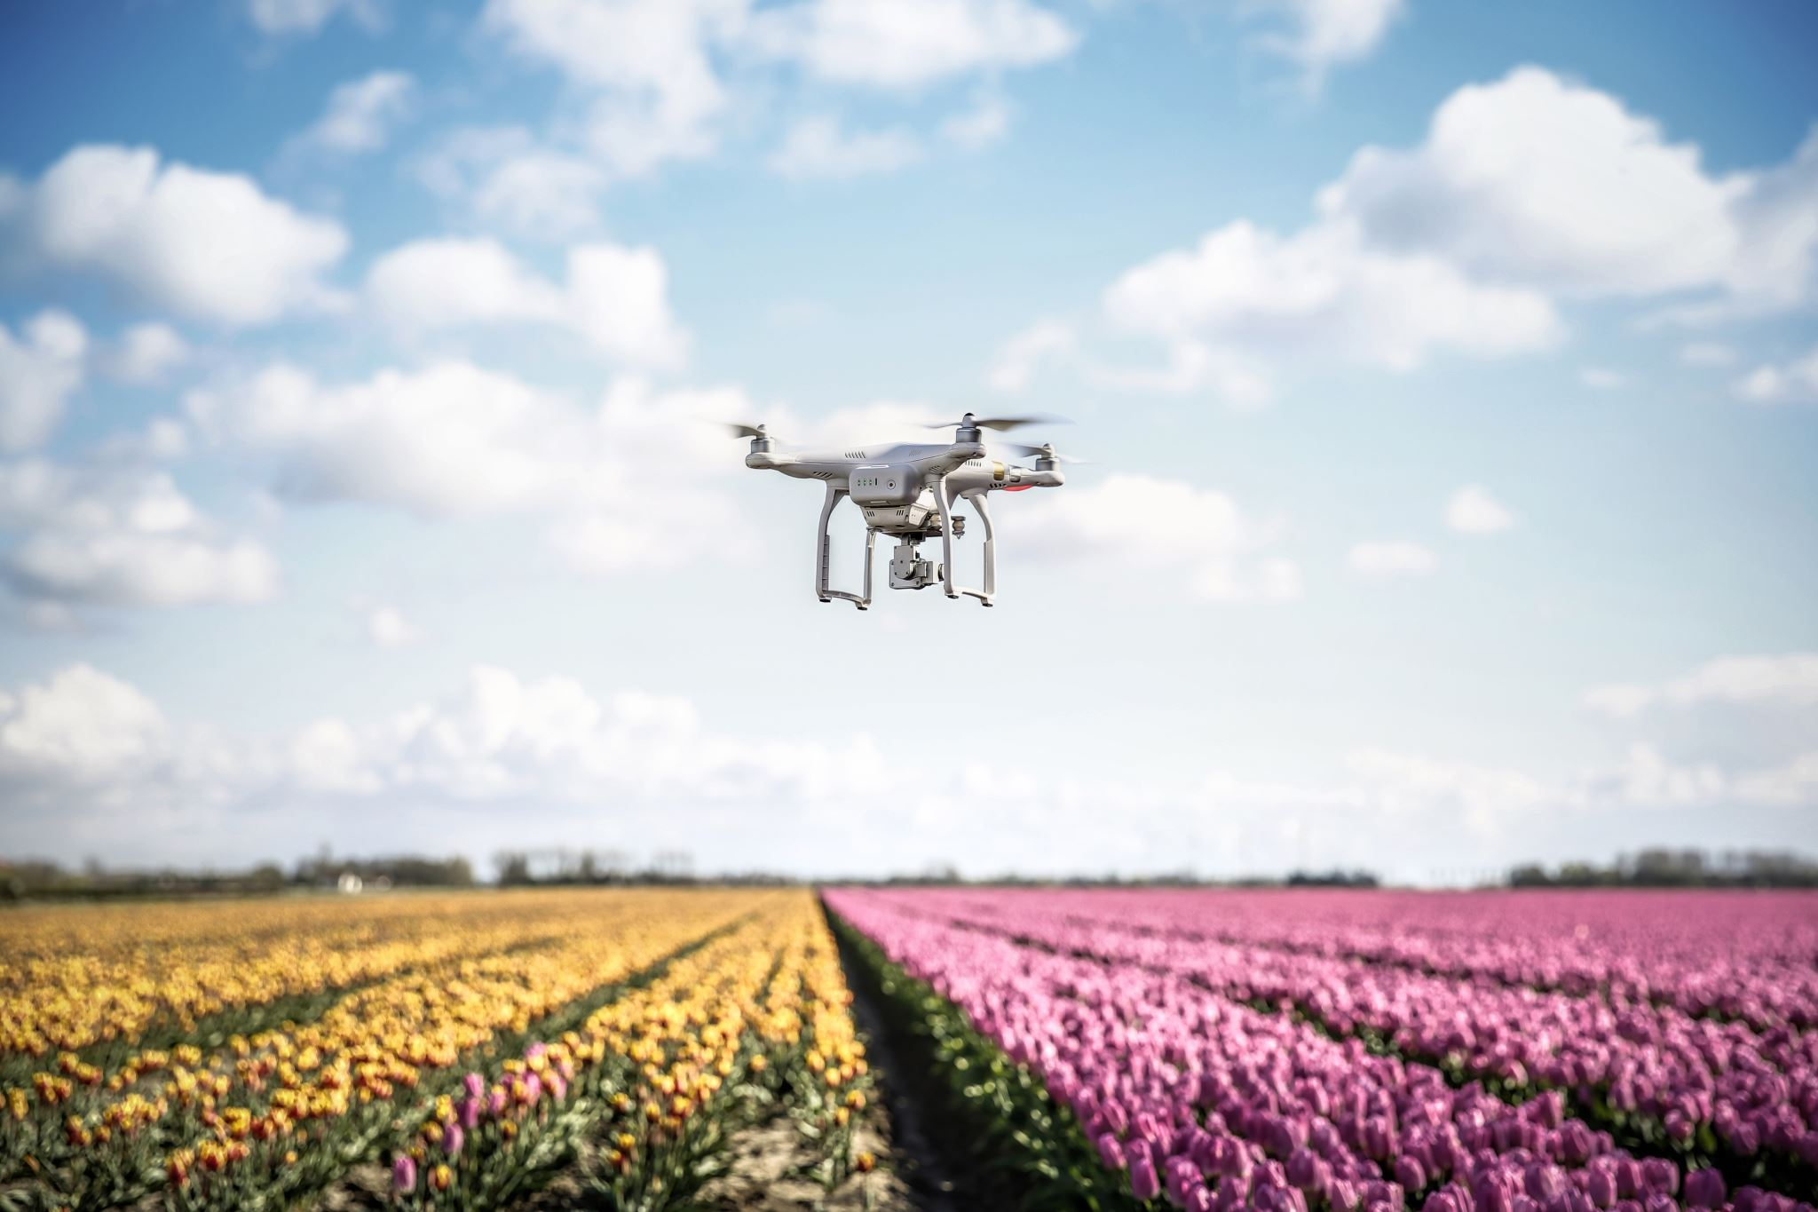
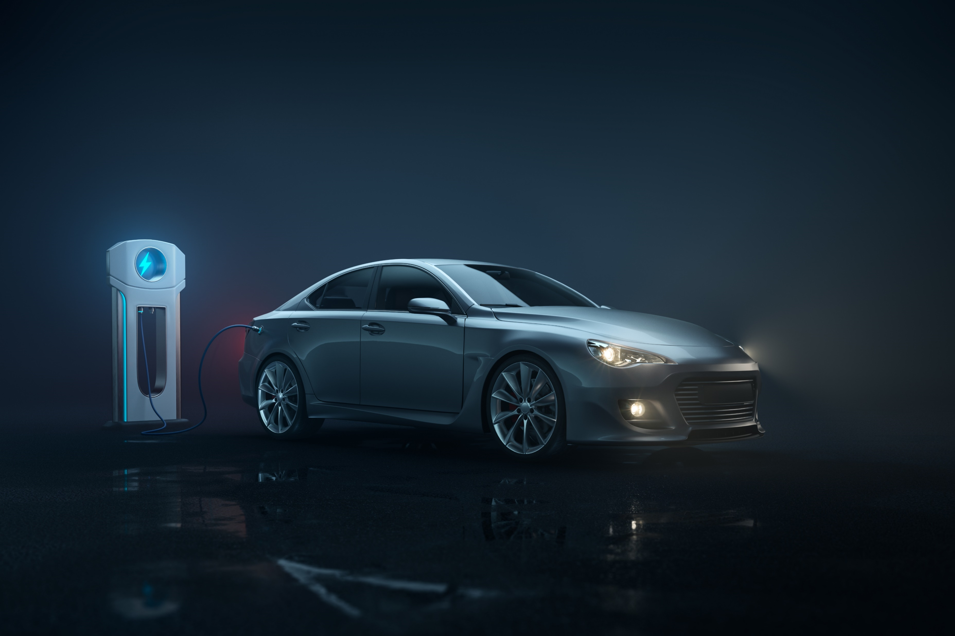
Science drives exploration, exploration benefits humankind

Slide 61
Want to learn more?
Robotics and Autonomous Systems
https://www.mathworks.com/solutions/robotics.html
Deep Learning for Image Analysis
https://www.mathworks.com/solutions/deep-learning.html

Slide 62




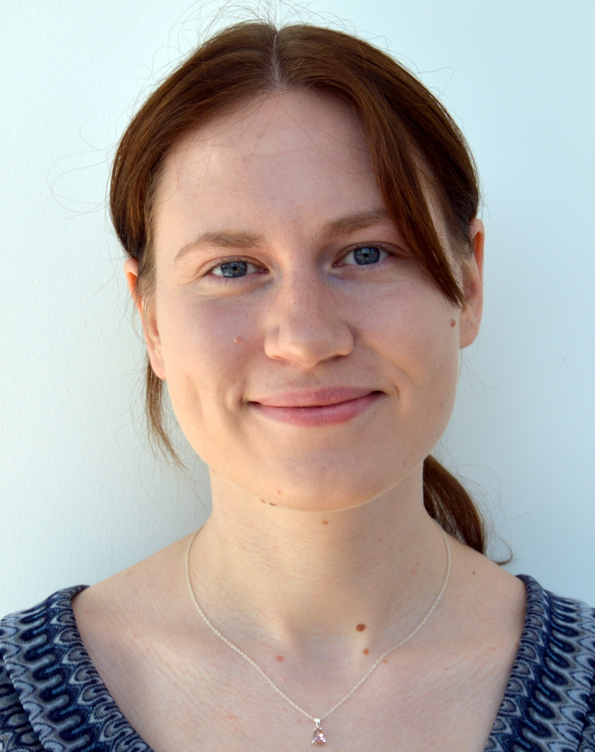


Thank you for the support
Ameya Godbole
Shruti Karulkar
Antonio Hidalgo
Harshal Upadhyay
Anoush Najarian
Sara Nambi
Gabija Marsalkaite

Slide 63
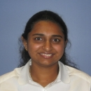










Shout out to the TA team!
Swetha Murali
Tharikaa R Kumar
Mahendra S Bisht
Xiao Liu
Carissa Gadson
Vaishnavi Katukollu
Timothy Kyung
Jayalekshmi V P
Anuja Pharse
Bonita Vormawor
Elvira Osuna-Highley

Slide 64

@MathWorks
|
MathWorks
@RamaniKritika
|
Kritika Ramani
|
Chinmayi Lanka
Continue the conversation with
#shelovesmatlab
#shelovessimulink
@MariaEGavilanA
|
Maria Gavilan
#NavigateOnMarsWithAI

